Slide 1
Multiple Kernel Learning
Manik Varma
Microsoft Research India

Slide 2
A Quick Review of SVMs
ξ > 1
Margin = 2 / √w^{t}w
Misclassified point
ξ < 1
b
Support Vector
ξ = 0
Support Vector
w^{t}x + b = -1
w
ξ = 0
w^{t}x + b = 0
w^{t}x + b = +1

Slide 3
The C SVM Primal and Dual
Primal P = Min_{w,ξ,b} ½w^{t}w + C^{t}ξ
s. t. Y(X^{t}w + b1) ≥ 1 – ξ
ξ ≥ 0
Dual D = Max_{α} 1^{t}α – ½α^{t}YKYα
s. t. 1^{t}Yα = 0
0 ≤ α ≤ C

Slide 4
Duality
Primal P = Min_{x} f₀(x)
s. t. f_{i}(x) ≤ 0 1 ≤ i ≤ N
h_{i}(x) = 0 1 ≤ i ≤ M
Lagrangian L(x,λ,μ) = f₀(x) + Σ_{i} λ_{i}f_{i}(x) + Σ_{i} μ_{i}h_{i}(x)
Dual D = Max_{λ,μ} Min_{x} L(x,λ,μ)
s. t. λ ≥ 0

Slide 5
Duality
The Lagrange dual is always concave (even if the primal is not convex) and might be an easier problem to optimize
Weak duality : P ≥ D
Always holds
Strong duality : P = D
Does not always hold
Usually holds for convex problems
Holds for the SVM QP

Slide 6
Karush-Kuhn-Tucker (KKT) Conditions
If strong duality holds, then for x*, λ* and μ* to be optimal the following KKT conditions must necessarily hold
Primal feasibility : f_{i}(x*) ≤ 0 & h_{i}(x*) = 0 for 1 ≤ i
Dual feasibility : λ* ≥ 0
Stationarity : ∇_{x} L(x*, λ*,μ*) = 0
Complimentary slackness : λ_{i}*f_{i}(x*) = 0
If x⁺, λ⁺ and μ⁺ satisfy the KKT conditions for a convex problem then they are optimal

Slide 7

Some Popular Kernels
Linear : K(x_{i},x_{j}) = x_{i}^{t}Σ⁻¹x_{j}
Polynomial : K(x_{i},x_{j}) = (x_{i}^{t}Σ⁻¹x_{j} + c)^{d}
Gaussian (RBF) : K(x_{i},x_{j}) = exp( –Σ_{k} γ_{k}(x_{ik} – x_{jk})²)
Chi-Squared : K(x_{i},x_{j}) = exp( –χ²(x_{i}, x_{j}) )
Sigmoid : K(x_{i},x_{j}) = tanh(x_{i}^{t}x_{j} – c)
Σ should be positive definite, c ≥ 0, γ ≥ 0 and d should be a natural number

Slide 8
Advantages of Learning the Kernel
Improve accuracy and generalization
Learn an RBF Kernel : K(x_{i},x_{j}) = exp( –γ Σ_{k} (x_{ik} – x_{jk})²)

Slide 9
Kernel Parameter Setting - Underfitting

Slide 10
Kernel Parameter Setting

Slide 11
Kernel Parameter Setting – Overfitting

Slide 12
Advantages of Learning the Kernel
Improve accuracy and generalization
Learn an RBF Kernel : K(x_{i},x_{j}) = exp( –γ Σ_{k} (x_{ik} – x_{jk})²)
Test error as a function of γ

Slide 13
Advantages of Learning the Kernel
Perform non-linear feature selection
Learn an RBF Kernel : K(x_{i},x_{j}) = exp(–Σ_{k} γ_{k}(x_{ik} – x_{jk})²)
Perform non-linear dimensionality reduction
Learn K(P_{θ}x_{i}, P_{θ}x_{j}) where P is a low dimensional projection matrix parameterized by θ
These are optimized for the task at hand such as classification, regression, ranking, etc.

Slide 14
Advantages of Learning the Kernel
Multiple Kernel Learning
Learn a linear combination of given base kernels
K(x_{i},x_{j}) = Σ_{k} d_{k} K_{k}(x_{i},x_{j})
Can be used to combine heterogeneous sources of data
Can be used for descriptor (feature) selection

Slide 15
MKL – Geometric Interpretation
MKL learns a linear combination of base kernels
K(x_{i},x_{j}) = Σ_{k} d_{k} K_{k}(x_{i},x_{j})
√d₁φ₁
√d₂φ₂
φ =
√d₃φ₃

Slide 16
MKL – Toy Example
Suppose we’re given a simplistic 1D shape feature for a binary classification problem
Define a linear shape kernel : K_{s}(s_{i},s_{j}) = s_{i}s_{j}
The classification accuracy is 100% but the margin is very small
s

Slide 17
MKL – Toy Example
Suppose we’re now given addition 1D colour feature
Define a linear colour kernel : K_{c}(c_{i},c_{j}) = c_{i}c_{j}
The classification accuracy is also 100% but the margin remains very small
c

Slide 18
MKL – Toy Example
MKL learns a combined shape-colour feature space
K(x_{i},x_{j}) = d K_{s}(x_{i},x_{j}) + (1 – d) K_{c}(x_{i},x_{j})
c
c
s
s
d = 0
d = 1

Slide 19
MKL – Toy Example

Slide 20
MKL – Another Toy Example
MKL learns a combined shape-colour feature space
K(x_{i},x_{j}) = d K_{s}(x_{i},x_{j}) + (1 – d) K_{c}(x_{i},x_{j})
c
c
s
s
d = 0
d = 1

Slide 21
MKL – Another Toy Example

Slide 22
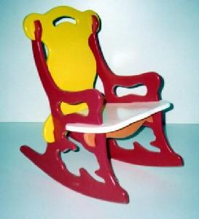
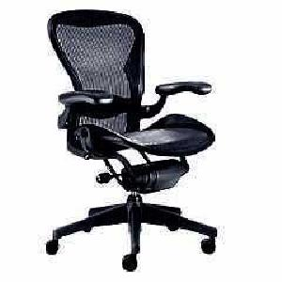
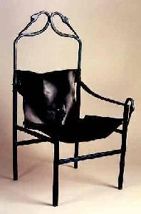
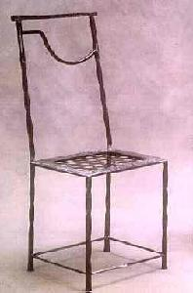
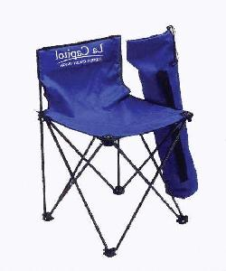

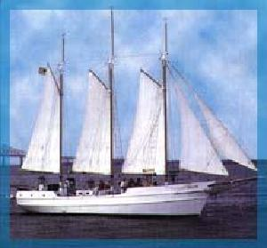
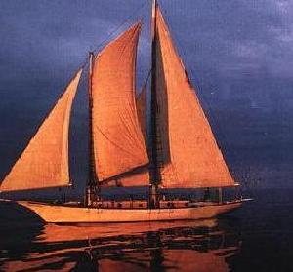
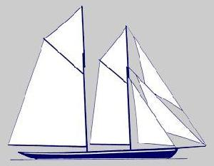
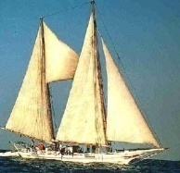
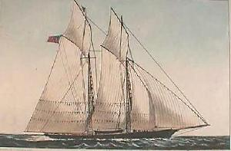
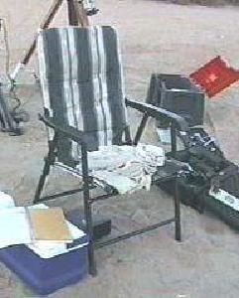
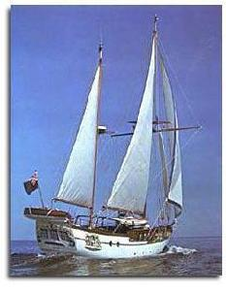
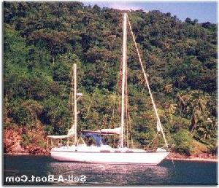
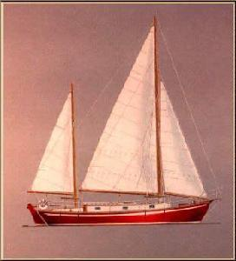
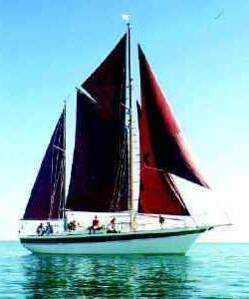
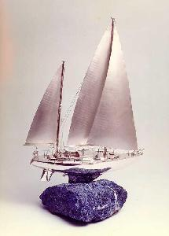


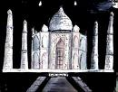


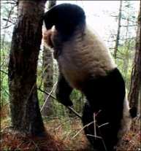
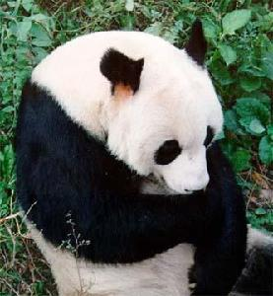
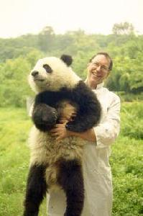
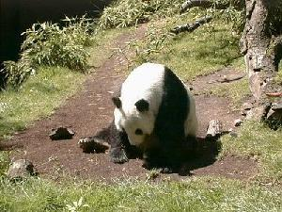

Object Categorization
Chair
Schooner
?
Ketch
Taj
Panda

Slide 23
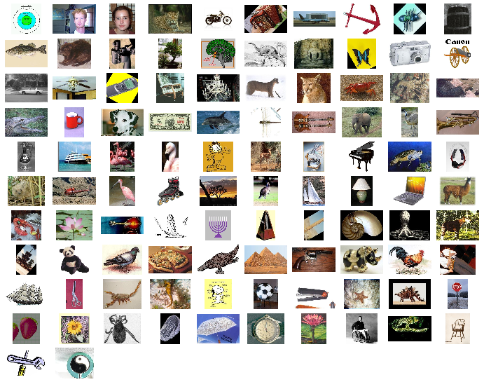
The Caltech 101 Database
Database collected by Fei-Fei et al. [PAMI 2006]

Slide 24
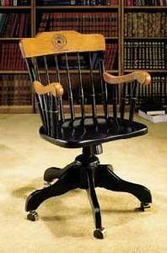
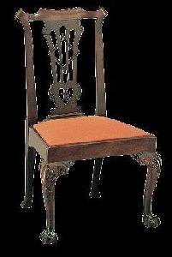
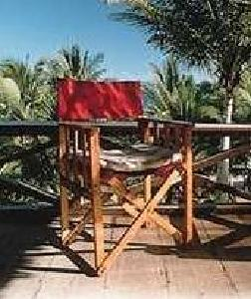
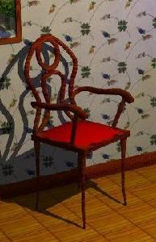
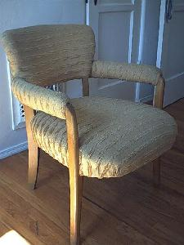
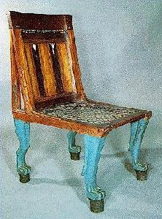
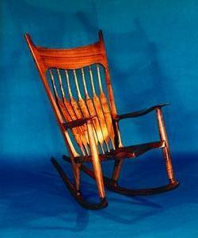
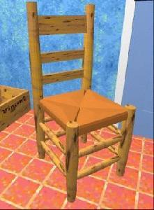

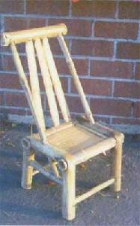
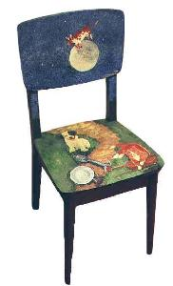
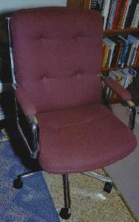
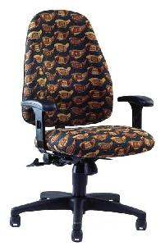
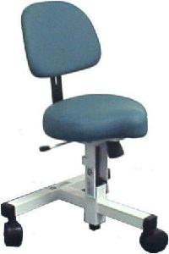
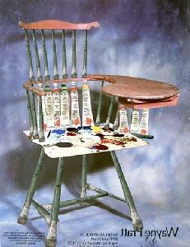
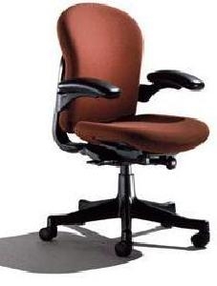
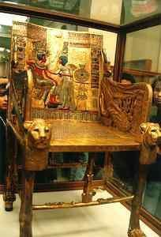
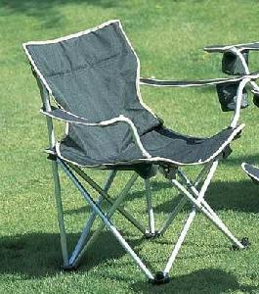
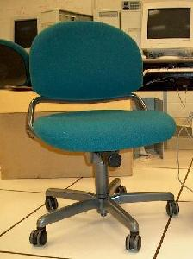
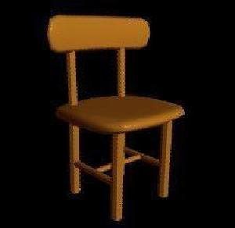

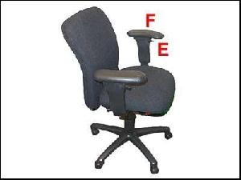

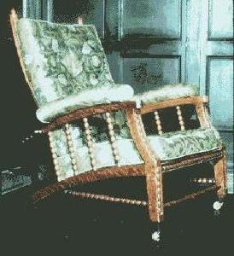
The Caltech 101 Database – Chairs

Slide 25
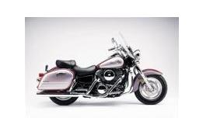
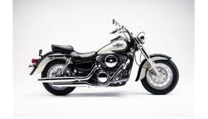
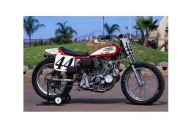
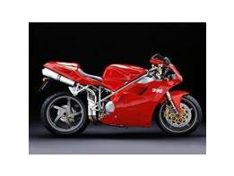
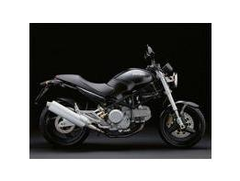
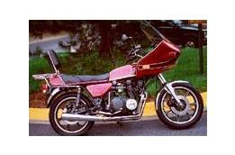
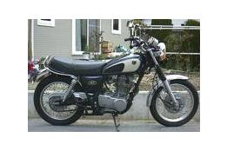























The Caltech 101 Database – Bikes

Slide 26
Caltech 101 – Features and Kernels
Features
Geometric Blur [Berg and Malik, CVPR 01]
PHOW Gray & Colour [Lazebnik et al., CVPR 06]
Self Similarity [Shechtman and Irani, CVPR 07]
Kernels
RBF for Geometric Blur
K(x_{i},x_{j}) = exp( – γ χ²(x_{i},x_{j})) for the rest

Slide 27
Caltech 101 – Experimental Setup
Experimental Setup
102 categories including Background_Google and Faces_easy
15 training and 15 test images per category
30 training and up to 15 test images per category
Results summarized over 3 random train/test splits

Slide 28
Caltech 101 – MKL Results

Slide 29
Caltech 101 – Comparisons
Method | 15 Training | 30 Training
LP-Beta [Gehler & Novozin, 09] | 74.6 ± 1.0 | 82.1 ± 0.3
GS-MKL [Yang et al., ICCV 09] | ≈74 | 84.3
Bayesian LMKL [Christoudias et al., Tech Rep 09] | 73.0 ± 1.3 | NA
In Defense of NN [Boiman et al., CVPR 08] | 72.8 | ≈79
MKL [Vedaldi et al., ICCV 09] | 71.1 ± 0.6 | 78.2 ± 0.4
LP-Beta [Gehler & Novozin, ICCV 09] | 70.4 ± 0.8 | 77.7 ± 0.3
Region Recognition [Gu et al., CVPR 08] | 65.0 | 73.1
SVM-KNN [Zhang et al., CVPR 06] | 59.06 ± 0.56 | 66.23 ± 0.48

Slide 30








Caltech 101 – Over Fitting?

Slide 31








Caltech 101 – Over Fitting?

Slide 32








Caltech 101 – Over Fitting?

Slide 33








Caltech 101 – Over Fitting?

Slide 34
















Caltech 101 – Over Fitting?

Slide 35
Wikipedia MM Subset
Experimental Setup
33 topics chosen each with more than 60 images
N_{train} = [10, 15, 20, 25, 30]
The remaining images are used for testing
Features
PHOG 180 & 360
Self Similarity
PHOW Gray & Colour
Gabor filters
Kernels
Pyramid Match Kernel & Spatial Pyramid Kernel

Slide 36
Wikipedia MM Subset
LMKL [Gonen and Alpaydin, ICML 08]
GS-MKL [Yang et al., ICCV 09]
N_{train} | Equal Weights | MKL | LMKL | GS-MKL
10 | 38.9±0.7 | 45.0±1.0 | 47.3±1.6 | 49.2±1.2
15 | 42.0±0.6 | 50.1±0.8 | 53.4±1.3 | 56.6±1.0
20 | 44.8±0.5 | 54.3±0.8 | 56.2±0.9 | 61.0±1.0
25 | 47.0±0.5 | 56.1±0.7 | 57.8±1.1 | 64.3±0.8
30 | 49.2±0.4 | 58.2±0.6 | 60.5±1.0 | 67.6±0.9

Slide 37


Feature Selection for Gender Identification
FERET faces [Moghaddam and Yang, PAMI 2002]
Males
Females

Slide 38
Feature Selection for Gender Identification
Experimental setup
1053 training and 702 testing images
We define an RBF kernel per pixel (252 kernels)
Results summarized over 3 random train/test splits

Slide 39
Feature Selection Results
# Pix | AdaBoost | Baluja et al. [IJCV 2007] | OWL-QN [ICML 2007] | LP-SVM [COA 2004] | SSVM QCQP [ICML 2007] | BAHSIC [ICML 2007] | MKL | GMKL
10 | 76.3 ± 0.9 | 79.5 ± 1.9 | 71.6 ± 1.4 | 84.9 ± 1.9 | 79.5 ± 2.6 | 81.2 ± 3.2 | 80.8 ± 0.2 | 88.7 ± 0.8
20 | - | 82.6 ± 0.6 | 80.5 ± 3.3 | 87.6 ± 0.5 | 85.6 ± 0.7 | 86.5 ± 1.3 | 83.8 ± 0.7 | 93.2 ± 0.9
30 | - | 83.4 ± 0.3 | 84.8 ± 0.4 | 89.3 ± 1.1 | 88.6 ± 0.2 | 89.4 ± 2.4 | 86.3 ± 1.6 | 95.1 ± 0.5
50 | - | 86.9 ± 1.0 | 88.8 ± 0.4 | 90.6 ± 0.6 | 89.5 ± 0.2 | 91.0 ± 1.3 | 89.4 ± 0.9 | 95.5 ± 0.7
80 | - | 88.9 ± 0.6 | 90.4 ± 0.2 | - | 90.6 ± 1.1 | 92.4 ± 1.4 | 90.5 ± 0.2 | -
100 | - | 89.5 ± 0.2 | 90.6 ± 0.3 | - | 90.5 ± 0.2 | 94.1 ± 1.3 | 91.3 ± 1.3 | -
150 | - | 91.3 ± 0.5 | 90.3 ± 0.8 | - | 90.7 ± 0.2 | 94.5 ± 0.7 | - | -
252 | - | 93.1 ± 0.5 | - | - | 90.8 ± 0.0 | 94.3 ± 0.1 | - | -
 | 76.3(12.6) | - | 91 (221.3) | 91 (58.3) | 90.8 (252) | - | 91.6(146.3) | 95.5 (69.6)
Uniform MKL = 92.6 ± 0.9 Uniform GMKL = 94.3 ± 0.1

Slide 40

Object Detection
Localize a specified object of interest if it exists in a given image

Slide 41




















The PASCAL VOC Challenge Database

Slide 42







PASCAL VOC Database – Cars

Slide 43







PASCAL VOC Database – Dogs

Slide 44
PASCAL VOC 2009 Database Statistics
Table 2: Statistics of the segmentation image sets.
 | train |  | val |  | trainval |  | test
 | img | obj | img | obj | img | obj | img | obj
Aeroplane | 47 | 53 | 40 | 48 | 87 | 101 | - | -
Bicycle | 39 | 51 | 38 | 50 | 77 | 101 | - | -
Bird | 55 | 74 | 52 | 64 | 107 | 138 | - | -
Boat | 48 | 75 | 39 | 48 | 87 | 123 | - | -
Bottle | 42 | 75 | 44 | 61 | 86 | 136 | - | -
Bus | 38 | 48 | 39 | 59 | 77 | 107 | - | -
Car | 63 | 94 | 51 | 96 | 114 | 190 | - | -
Cat | 45 | 58 | 53 | 58 | 98 | 116 | - | -
Chair | 69 | 152 | 55 | 108 | 124 | 260 | - | -
Cow | 30 | 67 | 36 | 62 | 66 | 129 | - | -
Diningtable | 48 | 49 | 40 | 43 | 88 | 92 | - | -
Dog | 43 | 52 | 58 | 71 | 101 | 123 | - | -
Horse | 42 | 57 | 50 | 60 | 92 | 117 | - | -
Motorbike | 47 | 51 | 36 | 49 | 83 | 100 | - | -
Person | 207 | 352 | 210 | 368 | 417 | 720 | - | -
Pottedplant | 43 | 66 | 45 | 97 | 88 | 163 | - | -
Sheep | 27 | 64 | 34 | 88 | 61 | 152 | - | -
Sofa | 44 | 52 | 53 | 65 | 97 | 117 | - | -
Train | 40 | 47 | 46 | 51 | 86 | 98 | - | -
Tvmonitor | 51 | 64 | 48 | 64 | 99 | 128 | - | -
Total | 749 | 1601 | 750 | 1610 | 1499 | 3211 | - | -
Table 1: Statistics of the main image sets. Object statistics list only the `non-difficult' objects used in the evaluation.
 | train |  | val |  | trainval |  | test
 | img | obj | img | obj | img | obj | img | obj
Aeroplane | 201 | 267 | 206 | 266 | 407 | 533 | - | -
Bicycle | 167 | 232 | 181 | 236 | 348 | 468 | - | -
Bird | 262 | 381 | 243 | 379 | 505 | 760 | - | -
Boat | 170 | 270 | 155 | 267 | 325 | 537 | - | -
Bottle | 220 | 394 | 200 | 393 | 420 | 787 | - | -
Bus | 132 | 179 | 126 | 186 | 258 | 365 | - | -
Car | 372 | 664 | 358 | 653 | 730 | 1317 | - | -
Cat | 266 | 308 | 277 | 314 | 543 | 622 | - | -
Chair | 338 | 716 | 330 | 713 | 668 | 1429 | - | -
Cow | 86 | 164 | 86 | 172 | 172 | 336 | - | -
Diningtable | 140 | 153 | 131 | 153 | 271 | 306 | - | -
Dog | 316 | 391 | 333 | 392 | 649 | 783 | - | -
Horse | 161 | 237 | 167 | 245 | 328 | 482 | - | -
Motorbike | 171 | 235 | 167 | 234 | 338 | 469 | - | -
Person | 1333 | 2819 | 1446 | 2996 | 2779 | 5815 | - | -
Pottedplant | 166 | 311 | 166 | 316 | 332 | 627 | - | -
Sheep | 67 | 163 | 64 | 175 | 131 | 338 | - | -
Sofa | 155 | 172 | 153 | 175 | 308 | 347 | - | -
Train | 164 | 190 | 160 | 191 | 324 | 381 | - | -
Tvmonitor | 180 | 259 | 173 | 257 | 353 | 516 | - | -
Total | 3473 | 8505 | 3581 | 8713 | 7054 | 17218 | - | -

Slide 45

Detection By Classification
Detect by classifying every image window at every position, orientation and scale
The number of windows in an image runs into the hundred millions
Even if we classify a window in a second it will take us many days to detect a single object in an image
Bird
No Bird

Slide 46

Fast Detection Via a Cascade
PHOW Gray
Fast Linear SVM
Jumping Window
PHOW Colour
PHOG
Quasi-linear SVM
Feature vector
PHOG Sym
Visual Words
Non-linear SVM
Self Similarity

Slide 47
MKL Detection Overview
First stage
Linear SVM
Jumping windows/Branch and Bound
Time = O(#Windows)
Second stage
Quasi-linear SVM
χ² kernel
Time = O(#Windows * #Dims)
Third stage
Non-linear SVM
Exponential χ² kernel
Time = O(#Windows * #Dims * #SVs)
Th

Slide 48
PASCAL VOC Evaluation
Predictions are evaluated using precision-recall curves based on bounding box overlap
Area Overlap = B_{gt} ∩ B_{p} / B_{gt} ∪ B_{p}
Valid prediction if Area Overlap > ½
Ground truth B_{gt}
B_{gt} ∩ B_{p}
Predicted B_{p}

Slide 49




Some Examples of MKL Detections

Slide 50




Some Examples of MKL Detections

Slide 51




Some Examples of MKL Detections

Slide 52


















Some Examples of MKL Detections
Aeroplanes
Bicycles
Cars
Cows
Horses
Motorbikes

Slide 53
Performance of Individual Kernels
MKL give a big boost over any individual kernel
MKL gives only marginally better performance than equal weights but results in a much faster system

Slide 54

PASCAL VOC 2009 Results

Slide 55
MKL Formulations and Optimization
Kernel Target Alignment
Semi-Definite Programming-MKL (SDP)
Hyper kernels (SDP/SOCP)
Block l₁-MKL (M-Y regularization + SMO)
Semi-Infinite Linear Programming-MKL (SILP)
Simple MKL/Generalized MKL (gradient descent)
Multi-class MKL
Hierarchical MKL
Local MKL
Mixed norm MKL (mirror descent)
SMO-MKL

Slide 56
Kernel Target Alignment
+1
-1
-1
+1
K_{ideal} = yy^{t} =

Slide 57
Kernel Target Alignment
eig(K)
λ₁, λ₂,v₁, v₂
,
K
K₁ = v₁v₁^{t}
K₂ = v₂v₂^{t}
=
+
K_{opt}
d₁
K₁
d₂
K₂
Small value
Large value

Slide 58
Kernel Target Alignment
K_{ideal}
Alignment
d₁ = 1
K_{opt}
d₂ = 1
K_{opt} = d₁ K₁ + d₂ K₂
such that d₁² + d₂² = 1

Slide 59
Kernel Target Alignment
Kernel Target Alignment [Cristianini et al. 2001]
Alignment
A(K₁,K₂) = <K₁,K₂> / (<K₁,K₁><K₂,K₂>)^{½}
where <K₁,K₂> = Σ_{i} Σ_{j} K₁(x_{i},x_{j})K₂(x_{i},x_{j})
Ideal Kernel: K_{ideal} = yy^{t}
Alignment to Ideal
A(K, K_{ideal}) = <K,yy^{t}> / n<K,K>^{½}
Optimal kernel
K_{opt} = Σ_{k} d_{k}K_{k} where K_{k} = v_{k}v_{k}^{t} (rank 1)

Slide 60
Kernel Target Alignment
Kernel Target Alignment
Optimal Alignment:
A(K_{opt}) = Σ d_{k}<v_{k},y>² / n(Σ d_{k}²)^{½}
Assume Σ d_{k}² = 1
Lagrangian
L(λ,d) = Σ d_{k}<v_{k},y>² – λ(Σ d_{k}² – 1)
Optimal weights: d_{k} ∝ <v_{k},y>²

Slide 61
Kernel Target Alignment
One of the first papers to propose kernel learning.
Established taking linear combinations of base kernels
Efficient algorithm
Formulation based on l₂ regularization.
Some generalisation bounds have been given but the task is not directly related to classification
Does not easily generalize to other loss functions

Slide 62
Brute Force Search Over d
d₂
K = 0.5 K₁ + 0.5 K₂
d₁
K_{opt} = d₁ K₁ + d₂ K₂

Slide 63
Brute Force Search Over d
d₂
K = – 0.1 K₁ + 0.8 K₂
K = 0.5 K₁ + 0.5 K₂
d₁
K_{opt} = d₁ K₁ + d₂ K₂

Slide 64
Brute Force Search Over d
d₂
K = – 0.1 K₁ + 0.8 K₂
K = 0.5 K₁ + 0.5 K₂
d₁
K_{opt} = 1.2 K₁ – 0.3 K₂
K_{opt} = d₁ K₁ + d₂ K₂

Slide 65
SDP-MKL
d₂
NP Hard Region
Σ d_{k}= 1
d₁
K ≥ 0 (SDP)
Lanckriet et al.
K_{opt} = d₁ K₁ + d₂ K₂

Slide 66
SDP-MKL
SDP-MKL [Lanckriet et al. 2002]
Minimise ½w^{t}w + C Σ_{i}ξ_{i}
Subject to
y_{i} [w^{t}φ_{d}(x_{i}) + b] ≥ 1 – ξ_{i}
ξ_{i} ≥ 0
K = Σ_{k} d_{k}K_{k} ≥ 0 (positive semi-definite)
trace(K) = constant

Slide 67
SDP-MKL
Optimises an appropriate cost function depending on the task at hand
Other loss functions possible (square hinge, KTA, regression, etc)
The optimisation involved is an SDP
The optimization reduces to a QCQP if d ≥ 0
Sparse kernel weights are learnt in the QCQP formulation

Slide 68
Improving SDP
d₂
NP Hard Region
Bach et al. Sonnenberg et al. Rakotomamonjy et al.
Σ d_{k}= 1
d₁
K ≥ 0 (SDP Region)
K_{opt} = d₁ K₁ + d₂ K₂

Slide 69
Block l₁ MKL
SDP-MKL dual reduces to a non-smooth QCQP when d ≥ 0
Dual Min_{α} –1^{t}α + Max_{k} ½α^{t}YK_{k}Yα
s. t. 1^{t}Yα = 0
0 ≤ α ≤ C
SMO can not be applied since the objective is not differentiable

Slide 70
M–Y Regulrization
F_{M}(x) = Min_{y} f(y) + ½ ||y – x||_{M}²
F is differentiable even when f is not
The minimum of F and f coincide

Slide 71
Block l₁ MKL
Block l₁ MKL [Bach et al. 2004]
Min ½ (Σ_{k} σ_{k} ||w_{k}||₂)² + C Σ_{i}ξ_{i} + ½Σ_{k} a_{k}² ||w_{k}||₂²
s. t. y_{i} [Σ_{k} w_{k}^{t}φ_{k}(x_{i}) + b] ≥ 1 – ξ_{i}
ξ_{i} ≥ 0
M-Y regularization ensures differentiability
Block l₁ regularization ensures sparseness
Optimisation is carried out via iterative SMO

Slide 72
SILP-MKL
SILP-MKL [Sonnenberg et al. 2005]
Primal Min_{w} ½ (Σ_{k} ||w_{k}||₂)² + C Σ_{i}ξ_{i}
s. t. y_{i} [Σ_{k} w_{k}^{t}φ_{k}(x_{i}) + b] ≥ 1 – ξ_{i}
ξ_{i} ≥ 0
where (implicitly) d_{k} ≥ 0 and Σ_{k} d_{k} = 1

Slide 73
SILP-MKL
SILP-MKL [Sonnenberg et al. 2005]
Dual Max_{d} Min_{α} Σ_{k} d_{k} (½α^{t}YK_{k}Yα – 1^{t}α)
s. t. 1^{t}Yα = 0
0 ≤ α ≤ C
d_{k} ≥ 0
Σ_{k} d_{k} = 1
Iterative LP-QP solution?
A naive LP-QP solver will oscillate

Slide 74
SILP-MKL
SILP-MKL [Sonnenberg et al. 2005]
Dual Max θ
s. t. d_{k} ≥ 0, Σ_{k} d_{k} = 1
Σ_{k} d_{k} (½α^{t}YK_{k}Yα – 1^{t}α) ≥ θ
for all 1^{t}Yα = 0, 0 ≤ α ≤ C
In each iteration find the α that most violates the constraint Σ_{k} d_{k} (½α^{t}YK_{k}Yα – 1^{t}α) ≥ θ and add it to the working set
This can be done using a standard SVM by solving
α* = argmin_{α ∈ Θ} Σ_{k} d_{k} (½α^{t}YK_{k}Yα – 1^{t}α)

Slide 75
SILP-MKL
SILP-MKL [Sonnenberg et al. 2005]
Dual Max θ
s. t. d_{k} ≥ 0, Σ_{k} d_{k} = 1
Σ_{k} d_{k} (½α^{t}YK_{k}Yα – 1^{t}α) ≥ θ
for all 1^{t}Yα = 0, 0 ≤ α ≤ C
The SILP (cutting plane) method can solve a 1M point problem with 20 kernels
It generalizes to regression, novelty detection, etc.
The LP grows more complex with each iteration and the method does not scale well to a large number of kernels

Slide 76
Cutting Planes
For convex functions : f(x) = max_{w ∈ G,b} w^{t}x + b
∇_{x} f(x) = argmax_{w ∈ G} w^{t}x
G turns out to be the set of subgradients

Slide 77
Gradient Descent Based Methods
Chapelle et al. ML 2002
Simple MKL (Rakotomamonjy et al. ICML 2007, JMLR 2008]
Generalized MKL (Varma & Ray ICCV 2007, Varma & Babu ICML 2009]
Local MKL [Gonen & Alpaydin, ICML 2008]
Hierarchical MKL [Bach NIPS 2008]
Mixed norm MKL [Nath et al. NIPS 09]

Slide 78
GMKL Primal Formulation
Primal P = Min_{w,d,b} ½w^{t}w + Σ_{i} L(f(x_{i}), y_{i}) + r(d)
s. t. d ≥ 0
where f(x) = w^{t}φ_{d}(x) + b, L is a loss function and r is a regulariser on the kernel parameters
This formulation is not convex in general

Slide 79
GMKL Primal for Classification
Primal P = Min_{d} T(d)
s. t. d ≥ 0
T(d) = Min_{w,b} ½w^{t}w + C^{t}ξ + r(d)
s. t. y_{i}(w^{t} φ_{d}(x_{i}) + b) ≥ 1 – ξ_{i}
ξ_{i} ≥ 0
We optimize P using gradient descent
We need to prove that ∇_{d}T exists and calculate it efficiently
We optimize T using a standard SVM solver

Slide 80
Visualizing T

Slide 81
Visualizing T

Slide 82
GMKL Differentiability
Primal P = Min_{d} T(d)
s. t. d ≥ 0
W(d) = Max_{α} 1^{t}α – ½α^{t}YK_{d}Yα + r(d)
s. t. 1^{t}Yα = 0
0 ≤ α ≤ C
T = W by the principle of strong duality
∇_{d}W exists, by Danskin’s theorem, if
K is strictly positive definite
∇_{d}K and ∇_{d}r exist and are continuous

Slide 83
GMKL Gradient
Primal P = Min_{d} T(d)
s. t. d ≥ 0
W(d) = Max_{α} 1^{t}α – ½α^{t}YK_{d}Yα + r(d)
s. t. 1^{t}Yα = 0
0 ≤ α ≤ C
∇_{d}W = ( ... )∇α* – ½α*^{t}Y ∇KYα* + ∇r
= – ½α*^{t}Y ∇KYα* + ∇r

Slide 84
Final Algorithm
Initialise d⁰ randomly
Repeat until convergence
Form K using the current estimate of d
Use any SVM solver to obtain α*
Update d^{n+1} = max(0, d^{n} – ε^{n}∇W)
Code: http://research.microsoft.com/~manik/code/GMKL/download.html

Slide 85
L₂ MKL Formulation
Min _{w,b,d} ½ Σ_{k}w_{k}^{t}w_{k} + C Σ_{i} ξ_{i} + ½d^{t}d
s. t. y_{i}(Σ_{k} √d_{k}w_{k}^{t}φ_{k}(x_{i})+ b) ≥ 1 – ξ_{i}
ξ_{i} ≥ 0, d_{k} ≥ 0
Max_{α} 1^{t}α – (1/8) Σ_{k} (α^{t}YK _{k}Yα)²
s. t. 1^{t}Yα = 0
0 ≤ α ≤ C
Can be optimized via SMO
Roots of a cubic can be found analytically
Gradients can be maintained

